Slide 1

This will be a walkthrough of how I built an Amazon CloudFront, often known as a CDN.
Duration: 1h 30m.
AWS Region: US East (N. Virginia) us-east-1
AWS CloudFront

Slide 2
Fun Facts about CDN.
CloudFront is a content delivery network (CDN) offered by AWS.
CDN provides a globally-distributed network of proxy servers which cache content. i.e., web videos or other media, more locally to consumers, thus improving speed for downloading the content.
CloudFront service works on pay-as-you-go basis.
When CloudFront is enabled, the content is stored on the main S3 server.
Copies of this content are created on a network of servers around the world called CDN.

Slide 3
Task Details
Launch the AWS Console
Create an S3 Bucket
Upload a file to the S3 bucket.
Create Custom Error pages.
Make the objects public.
Create a new Amazon CloudFront distribution.
Accessing images through Cloudfront.
Configuring custom Error Page
Restricting the Geographic Distribution of your content.

Slide 4
Task 2 & 3
In this task I will create an S3 Bucket, note the S3 name must be globally unique.
Region: Select US East (N. Virginia) us-east-1
Object Ownership: Selected ACLs enabled option and choose Object writer as Object owner; because it enables you to manage access to buckets and objects.
Block Public Access settings for bucket and Uncheck the Block all Public Access and acknowledge the change.
Task3; is mainly about uploading an image in the bucket and naming it, I've simply uploaded a Png image file into the bucket folder.

Slide 5
Task 4
This step entails creating custom error pages in the bucket folder so that CloudFront may return them when the origin returns HTTP 4xx or 5xx errors.
I've created an Error page.html using this simple .html file (<html><h1>This is Error Page</h1></html>) and then uploaded it to S3 bucket.
The same goes to block.html page and then uploaded it to the CustomErrors folder.

Slide 6
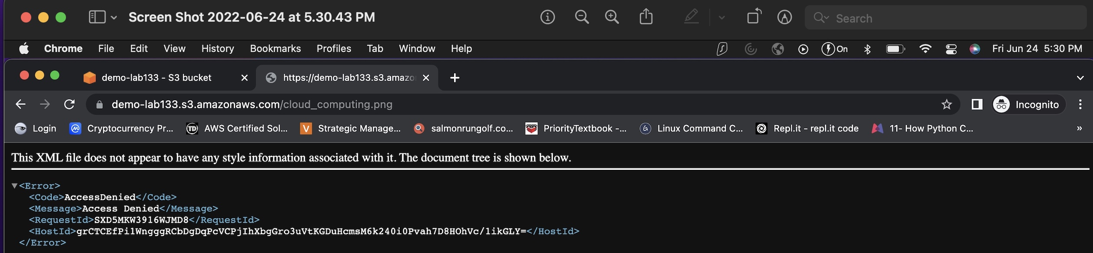
Task 5:
Making the objects public
Click on the image to see the owner, size, link, etc.
First, I tested the Object URL on a new browser tab, then you will see a denied access.

Slide 7
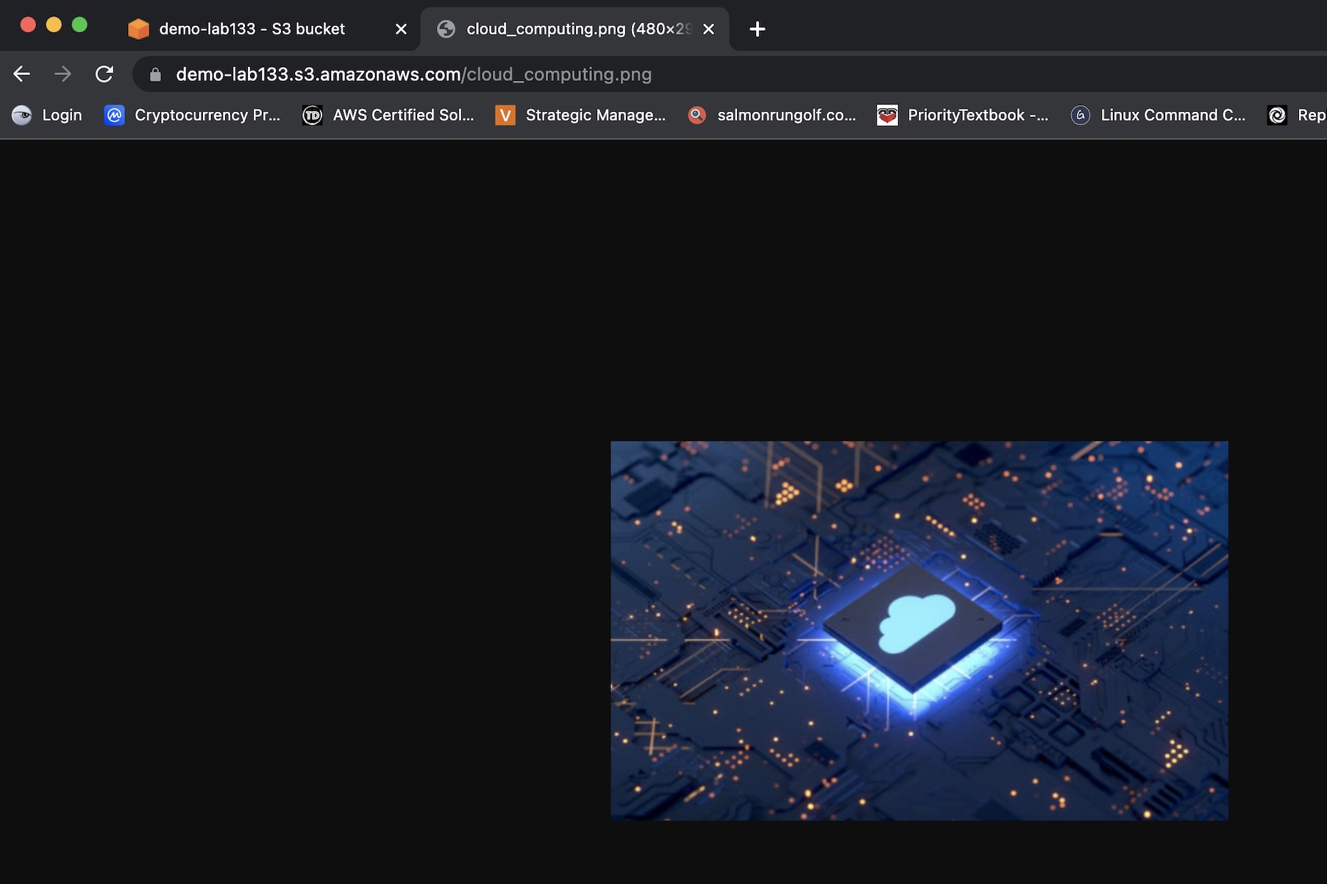
...
To access the bucket, I've edited the bucket policy under the bucket name and copy and pasted it with a JSON policy and saved the policy.
I make sure to change the name of the bucket ARN with your bucket ARN in both the Resource option in the code.
Refresh the page to access the bucket image.

Slide 8
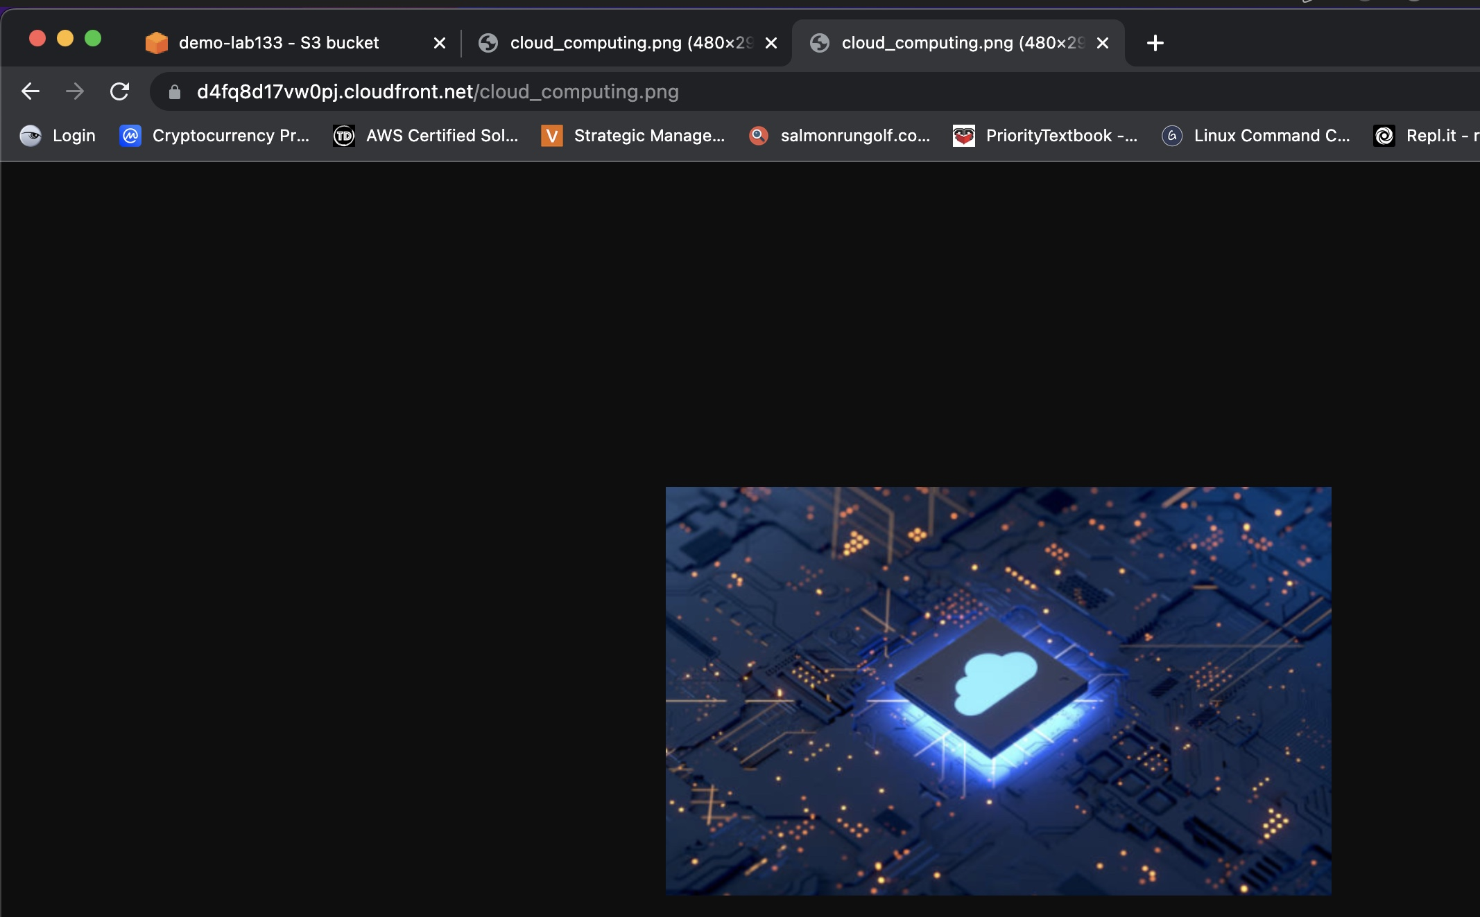
Task 6 & 7
Creating CloudFront Distribution
Once I created the CDN, the domain name should look something like this, (https://d4fq8d17vw0pj.cloudfront.net)
Task 7: is about testing the image through CloudFront.
For testing the distribution, I copied the domain name and append my bucket image name after the domain name.
Then I opened the CloudFront URL in a new tab to access the image.

Slide 9
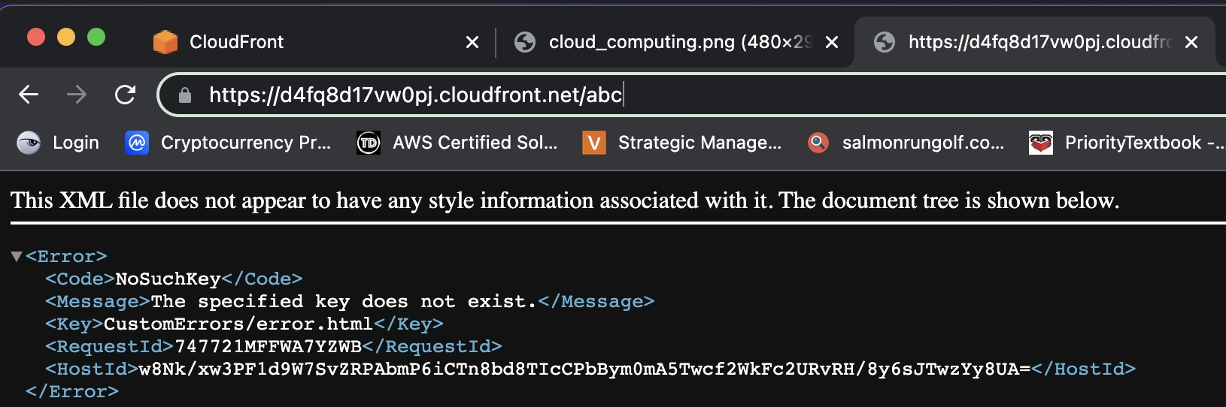
Task 8
Configuring Custom Error Page
Select the Error pages tab in the Distribution, then I set up the custom error page.
Http Error Code : Select 404: Not Found
Error Caching Minimum TTL: Enter 10
Customize Error Response : Select Yes
Response Page Path : Enter /CustomErrors/error.html
HTTP Response Code : Select 404: Not Found
I waited for the distribution state to change to deployed to test the error page
Then I entered a URL of image which does not exist in my S3 bucket with CloudFront domain name.

Slide 10
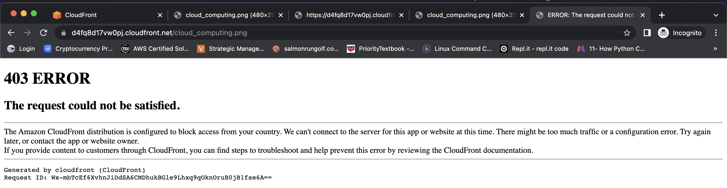
Task 9
Restricting the Geographic Distribution of Your Content.
This task is when I need to prevent users from accessing my content in specific countries by setting either a whitelist (countries where they can access my content) or a blacklist (countries where they cannot) using restrictions.
On the distribution settings page, I selected Geographic restriction & then edit.
Restriction Type : Select Block list
I've selected United States for restricting my content.
Waited for 5-10 minutes for the state to change to deployed, then I can test the block list restriction page.

Slide 11
Task 9 Step3:
It's time to configure custom error page:
Navigate back to CloudFront Dashboard and selected the distribution .
On the settings, select Error pages tab.
Now we need to set up our custom error page:
Http Error Code : Select 403: Forbidden
Error Caching Minimum TTL: Enter 10
Customize Error Response : Select Yes
Response Page Path : Enter /CustomErrors/block.html
HTTP Response Code : Select 403: Forbidden
Navigated back to the distribution to test restriction through CloudFront in the browser.
Next page for the result screenshot..

Slide 12
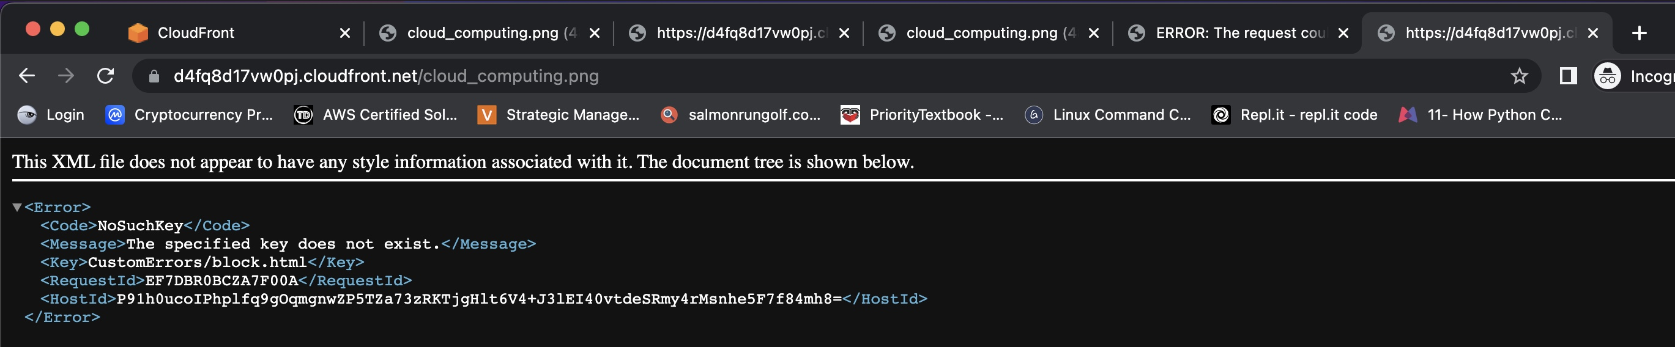
Testing result
If I see the error, this means I successfully configured custom error page and restricted image access from your country.

